Slide 1
Library Instruction
Basic Searching

Slide 2
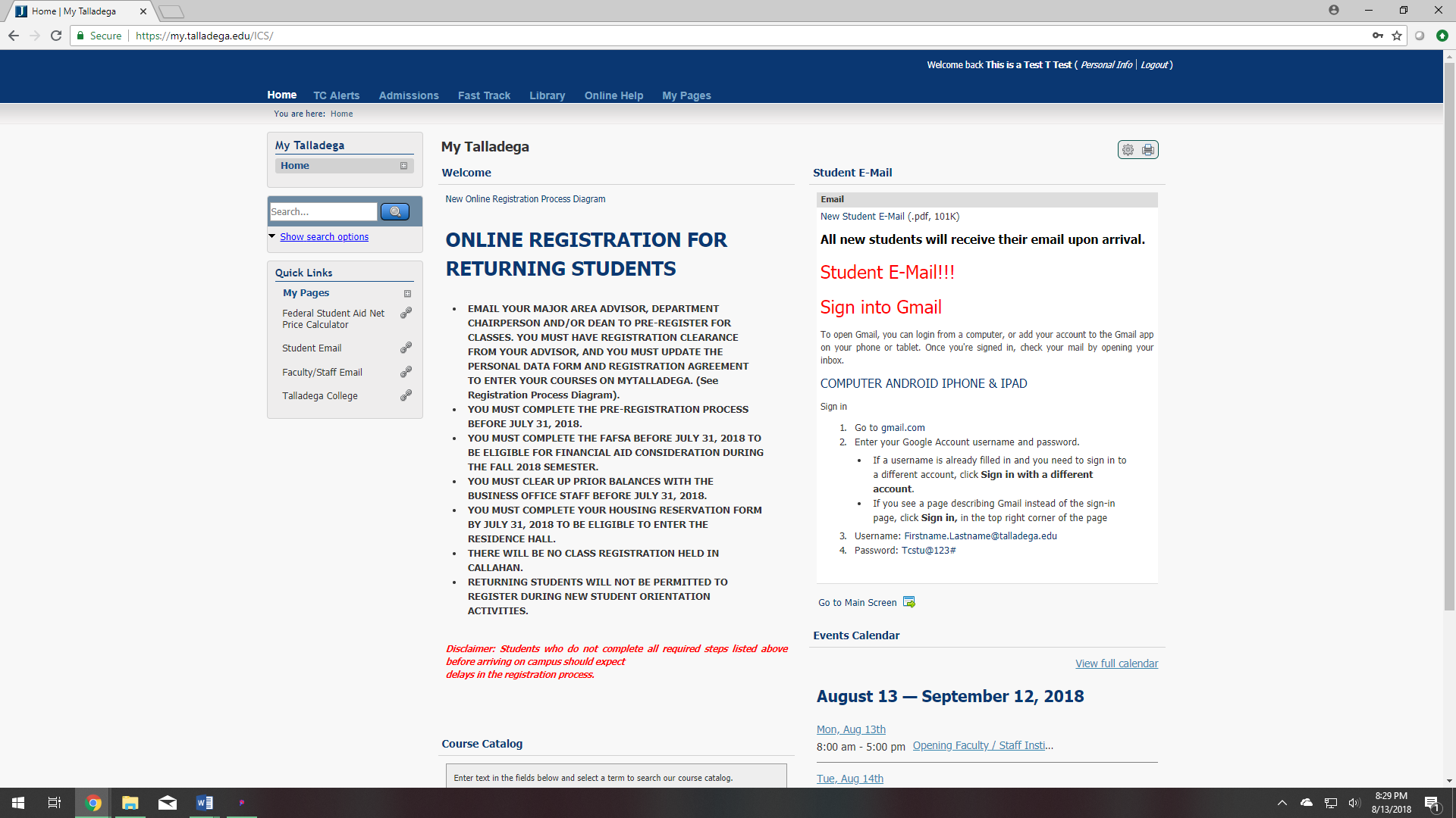
After signing into MyTalladega, click on the Library tab to go to the Library Page.

Slide 3
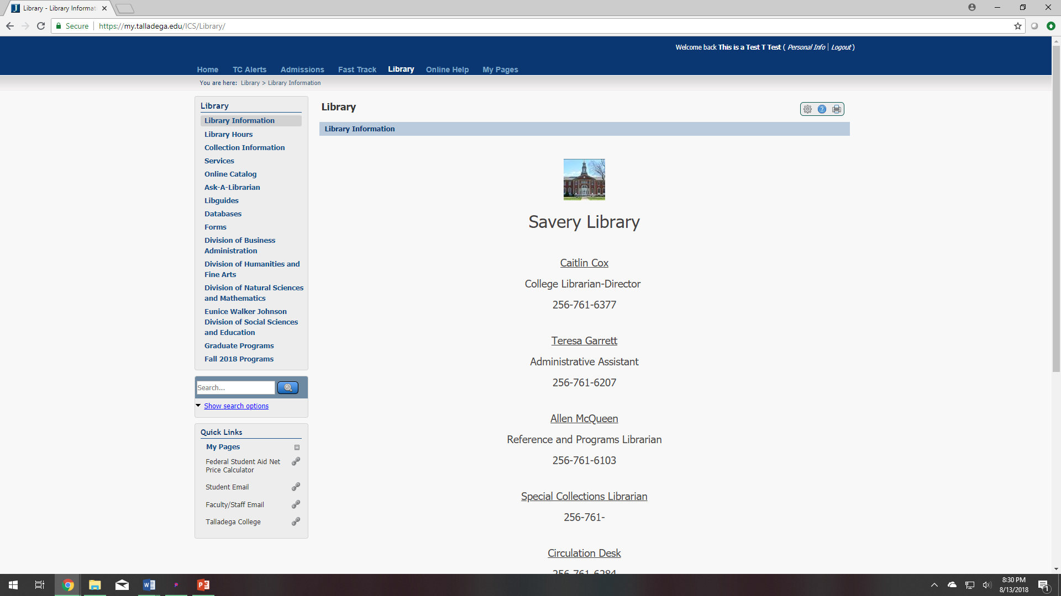
Then you will click on the Online Catalog link on the left side of the page.

Slide 4
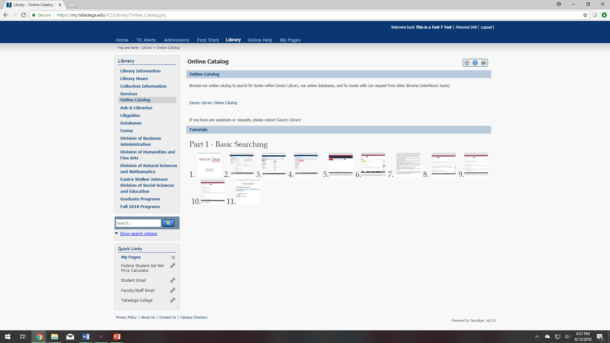
This will take you to the link for the Online Catalog, EBSCO Discovery.
***Note: this is where you will also find other library tutorials***

Slide 5
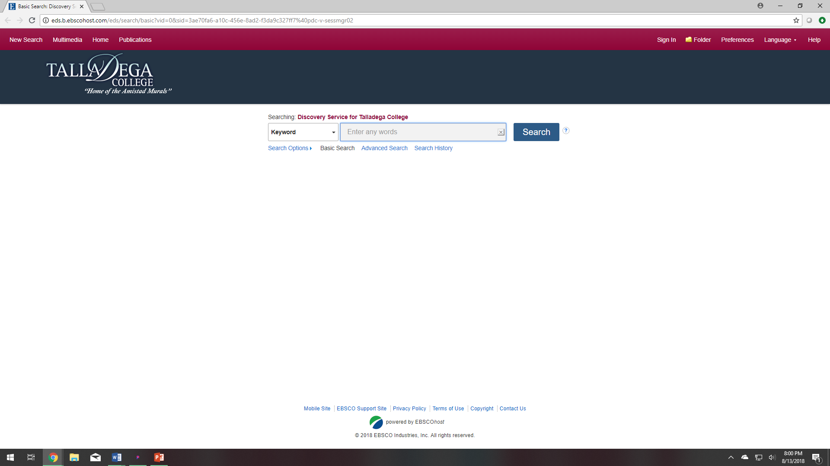
This is EBSCO Discovery. It searches all Talladega College subscribed databases, AVL databases, and the physical items that Savery Library holds. Enter your search term in the search box (ex. Civil rights).

Slide 6
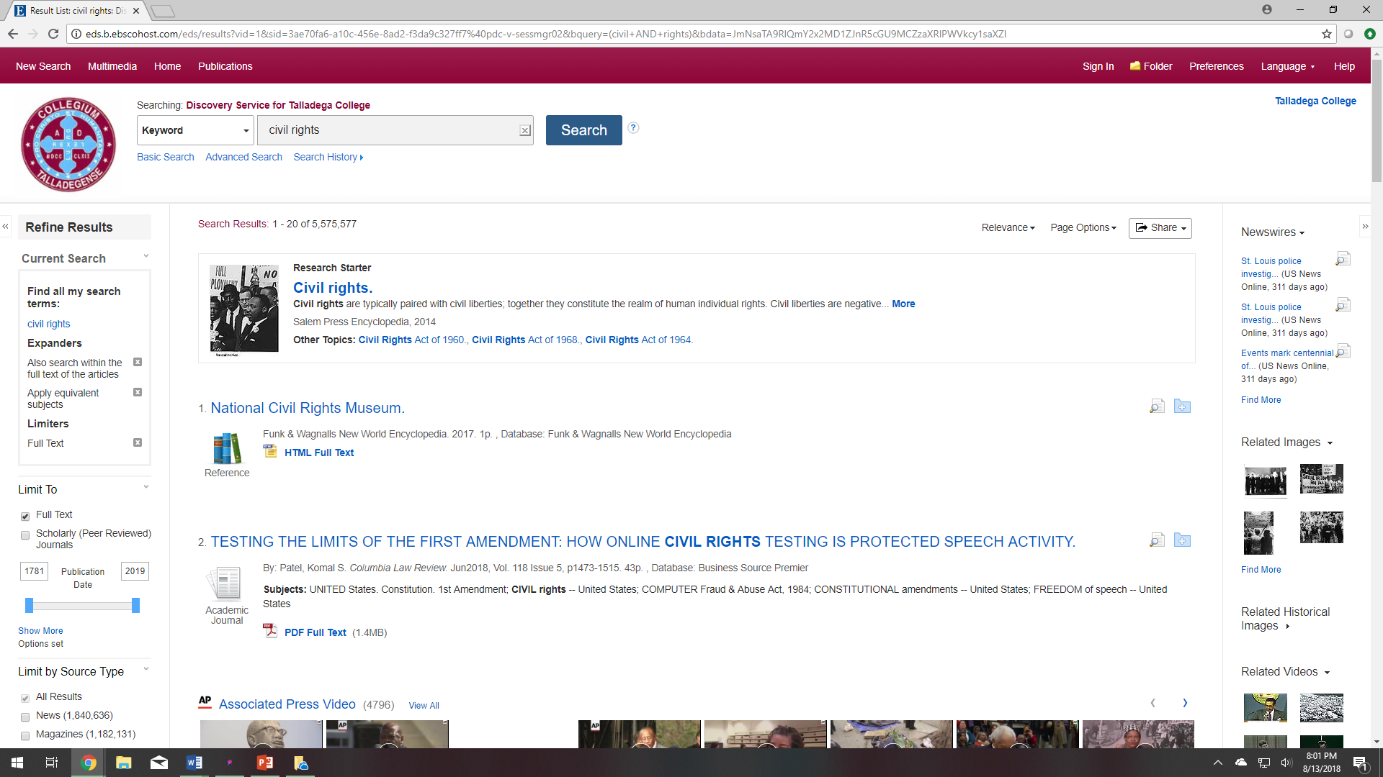
After your search completes you will see the total number of results.
Many searches begin too broad. It is now time to narrow the results.
First, you will want to refine your results using the box on the left
*Note: all searches have a “Research Starter” as the top result, this is designed to simplify the research experience. It includes links to relevant articles, images, videos, and audio clips with content pulled from a variety of high quality sources.

Slide 7
Begin by refining your results by noting that the Full Text limiter allows you to limit to items that Scholarly (Peer Reviewed) Journals, this is information that is scholarly in nature.
Additional options for refining results are: Source Types, Subjects, Publication, Publisher, Language, Geography, and Content Provider
Source Types: Includes magazines, newspapers, reviews, conference papers, reports, academic journals, and many more.
Subject: With broad topics, subjects can help narrow results by searching for terms commonly used to describe similar records.
Publication: provides an overview of the key journals, magazines, or other source types in your topic area and allows you to quickly filter your results.
Publisher: If Publication is too specific, or you are not familiar enough with publications, you can limit instead by Publisher. This allows you to see all items provided by one or more specific publishers.
Language: You can limit to items written in other languages.
Geography: You can also limit to a specific location
Content Provider: If you are familiar with the databases, you can limit your search to one specific database.
Using limiters will greatly decrease your results if you have a broad search topic with a high number of search results. If you are having issues finding items to support your search term, if it is too narrow, than limiters can help increase your search results by finding like terms.

Slide 8
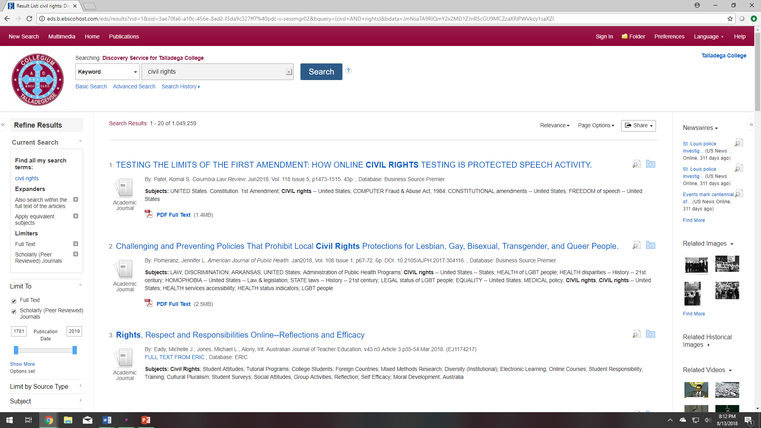
After refining results with only Scholarly (Peer Reviewed) Journals, the number greatly decreases, but still too many results. Try adding new limiters.

Slide 9
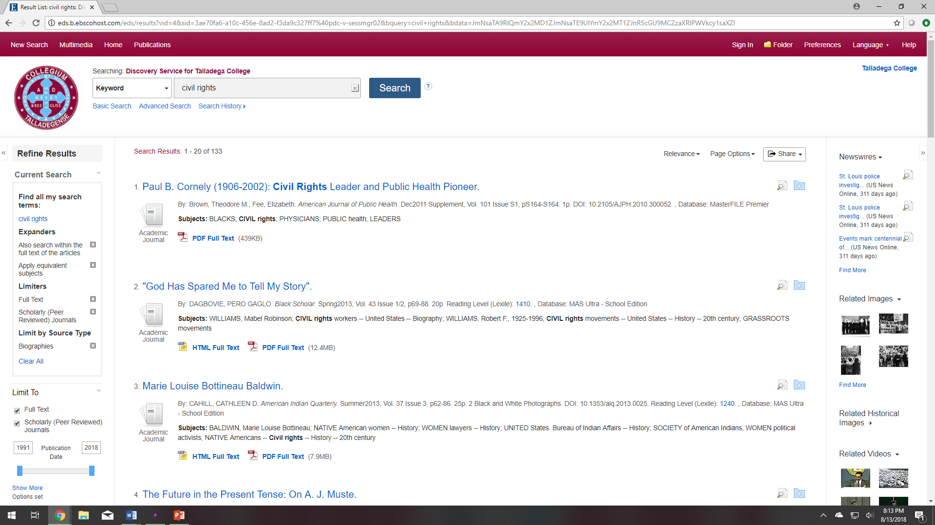
By adding one additional limiter, Source Type: Biographies, I decreased my search results from 5.5 MILLION to only 133.

Slide 10
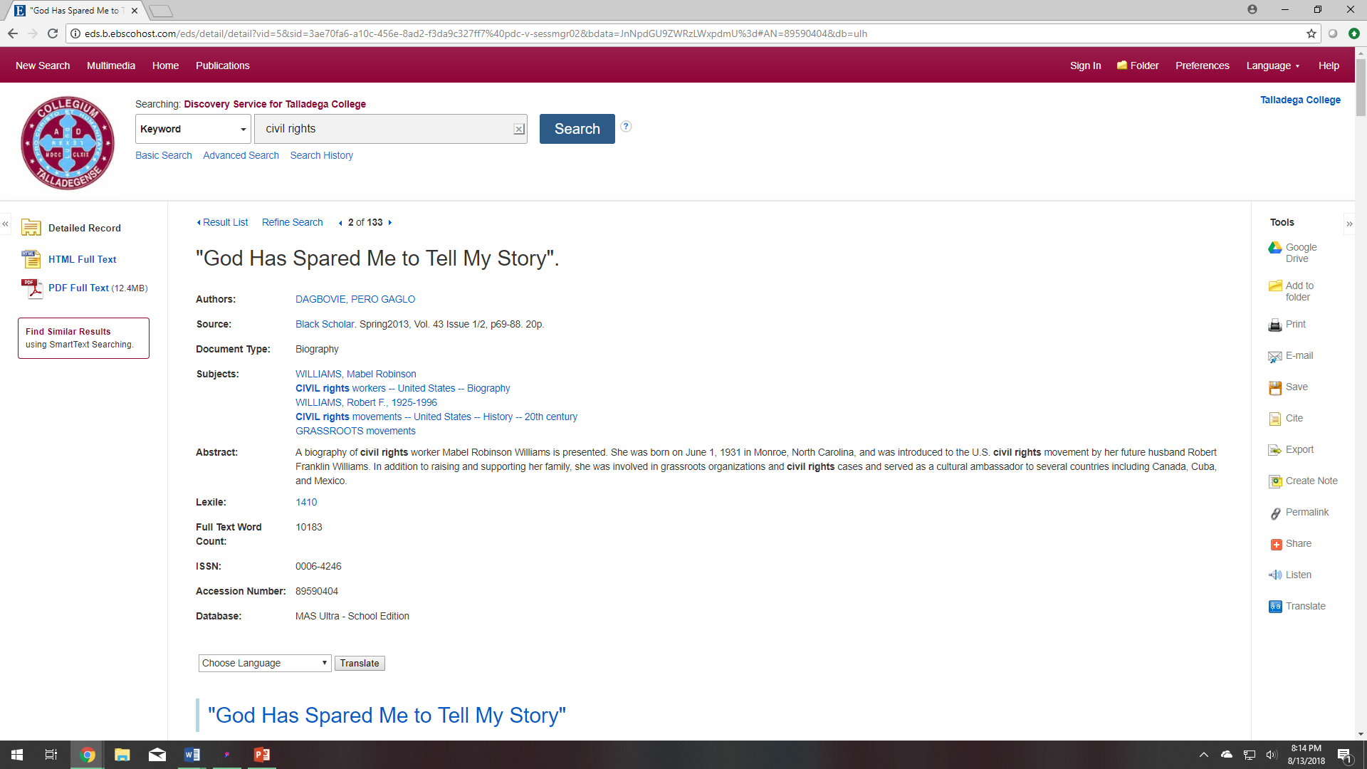
After click on the title, you have many options. You can view the PDF, Cite, email it to yourself, save it, add it to your folder, print the item, or share the item.

Slide 11
Any Questions?
Call us: 256-761-6284 or 256-761-6377
Email us: tclibrary@Talladega.edu, cmcox@Talladega.edu, amcqueen@Talladega.edu
Come by!
Monday – Thursday: 8am – 11pm
Friday: 8am – 5pm
Saturday/Sunday: 11am – 8pm

